Slide 1

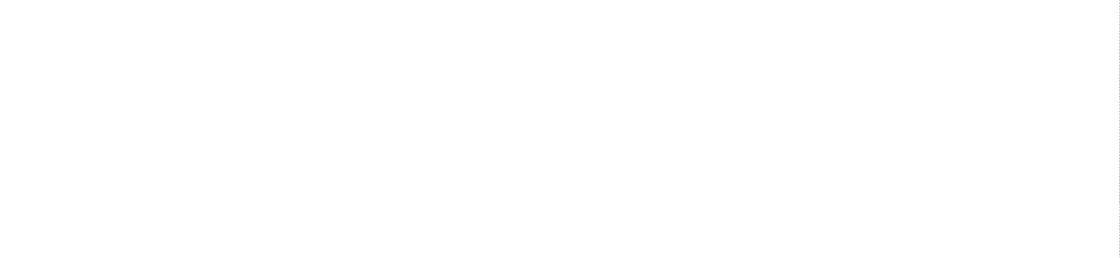
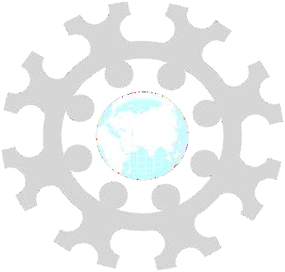
INSTITUTE: UIE (AIT-CSE)
CSS21: B.E. CSE (H) with specialization in Artificial Intelligence & Machine Learning
Advanced Machine Learning (20CSF-349)
Chapter 2.2.3 & 2.24: Support Vector Machine (SVM)
Lecture 21 & 22:Soft Margin Classifier & Slack variable
By: Mr. Siddharth Kumar
DISCOVER . LEARN . EMPOWER

Slide 2
Advanced Machine Learning
Course Outcome
CO | Title
1 | Have a good understanding of the fundamental issues and challenges of machine learning: data, model selection, model complexity, etc.
2 | Appreciate the underlying mathematical relationships within and across Machine Learning algorithms and the paradigms of supervised and un-supervised learning
3 | Design and implement various machine learning algorithms in a range of real-world applications.
4 | Design and evaluate intelligent expert models for perception and prediction using machine learning algorithms
5 | Analyze and make use of machine learning algorithms-based applications using performance

Slide 3
Soft Margin Classifier
In practice, real data is messy and cannot be separated perfectly with a hyperplane.
The constraint of maximizing the margin of the line that separates the classes must be relaxed. This is often called the soft margin classifier. This change allows some points in the training data to violate the separating line.
An additional set of coefficients are introduced that give the margin wiggle room in each dimension. These coefficients are sometimes called slack variables. This increases the complexity of the model as there are more parameters for the model to fit to the data to provide this complexity.
A tuning parameter is introduced called simply C that defines the magnitude of the wiggle allowed across all dimensions. The C parameters defines the amount of violation of the margin allowed. A C=0 is no violation and we are back to the inflexible Maximal-Margin Classifier described above. The larger the value of C the more violations of the hyperplane are permitted.

Slide 4
During the learning of the hyperplane from data, all training instances that lie within the distance of the margin will affect the placement of the hyperplane and are referred to as support vectors. And as C affects the number of instances that are allowed to fall within the margin, C influences the number of support vectors used by the model.
The smaller the value of C, the more sensitive the algorithm is to the training data (higher variance and lower bias).
The larger the value of C, the less sensitive the algorithm is to the training data (lower variance and higher bias).
What Soft Margin does is
it tolerates a few dots to get misclassified
it tries to balance the trade-off between finding a line that maximizes the margin and minimizes the misclassification.

Slide 5
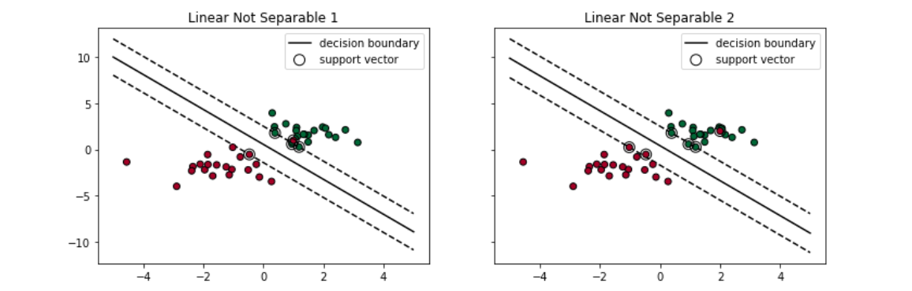
Two types of misclassifications can happen:
The dot is on the wrong side of the decision boundary but on the correct side/ on the margin (shown in left)
The dot is on the wrong side of the decision boundary and on the wrong side of the margin (shown in right)
Either case, the support vector machine tolerates those dots to be misclassified when it tries to find the linear decision boundary.

Slide 6
Slack Variable
Many datasets will not be linearly separable. As a result, there will be no way to satisfy all the Constraints. One way to cope with such datasets and still learn useful classifiers is to loosen some of the constraints by introducing slack variables.
Slack variables are introduced to allow certain constraints to be violated. That is, certain training points will be allowed to be within the margin.
The standard SVM classifier works only if you have a well separated categories. To be more specific, they need to be linearly separable. It means there exist a line (or hyperplane) such that all points belonging to a single category are either below or above it.
In many cases that condition is not satisfied, but still the two classes are pretty much separated except some small training data where the two categories overlap. It wouldn’t be a huge error if we would draw a line (somewhere in between) and accept some level of error - having training data on the wrong side of the marginal hyperplanes.

Slide 7
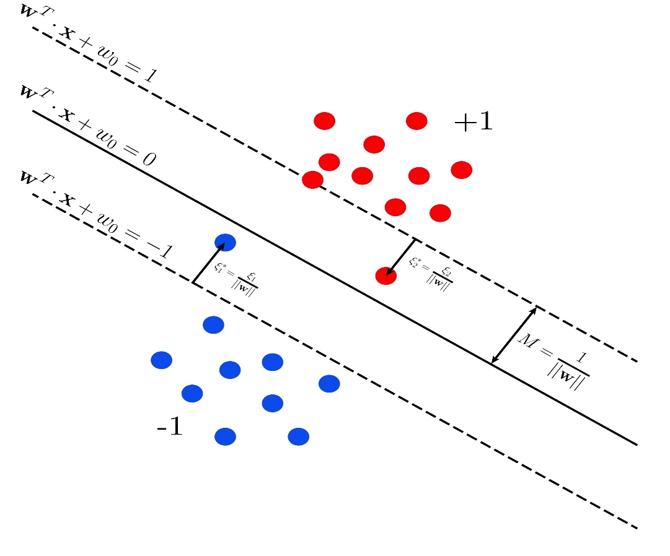
How do we measure the error? The answer is: slack variables. For each training data point we can define a variable that measures the distance of the point to its marginal hyperplane (dahsed line in the figure), lets call it ξ∗_{i} . Whenever the point is on the wrong site of the marginal hyperplane we quantify the amount of error by the ratio between ξ∗_{i} and half of the margin, i.e. distance between separating hyperplane and marginal hyperplane. Points on the correct site are not quantified as errors. This is a geometrical interpretation of slack variables ξ_{i} . You can now go back to the initial SVM problem and maximize the margin in the presence of errors. The larger the error that you allow for, the wider the margin.

Slide 8
References
T1: Mitchell T.M., Machine Learning, McGraw Hill (1997).
T2: Andreas C. Miller, Sarah Guido, Introduction to Machine Learning with Python, O’REILLY (2001).
Notes:
Introduction to Cyber Security (simplilearn.com)

Slide 9

THANK YOU

